Slide 1
speaking

Slide 2
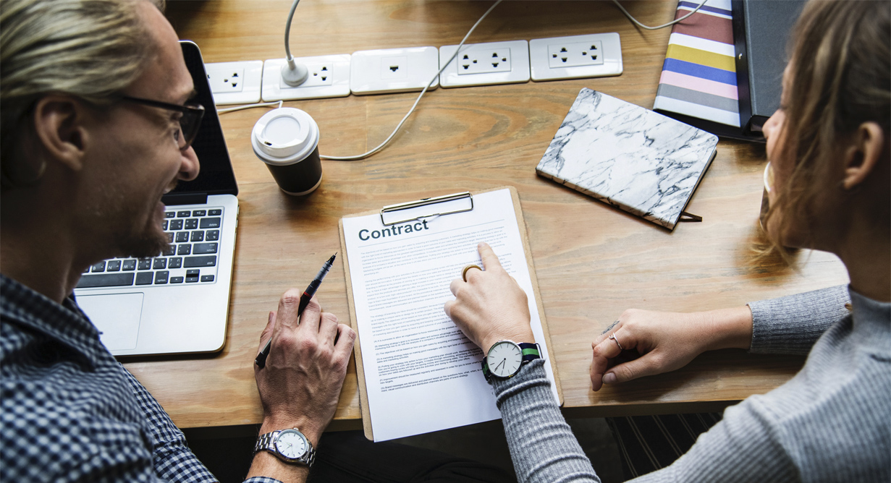

SPEAKING
Speaking skills are defined as the skills which allow us to communicate effectively. They give us the ability to convey information verbally and in a way that the listener can understand.
The four elements of speaking skills
Vocabulary
Grammar
Pronunciation
Fluency

Slide 3

Greetings in English
Telephone English
Small Talk in English
Presentations in English
Speaking about the Weather in English
Agreeing and Disagreeing in English

Slide 4
Art
Graffiti:
Some people consider graffiti to be another form of artistic expression, while others consider graffiti to be vandalism. What is your opinion? - Theater and Cinema: Discussion of various aspects of theater and cinema, such as history, genres, acting, etc.

Slide 5
Languages
Learning foreign languages:
Issues related to learning foreign languages, teaching methods and overcoming difficulties

Slide 6
Art
Graffiti:
Some people consider graffiti to be another form of artistic expression, while others consider graffiti to be vandalism. What is your opinion? - Theater and Cinema: Discussion of various aspects of theater and cinema, such as history, genres, acting, etc.

Slide 7
Journeys
Urban and Rural life:
Comparison and discussion of the differences between urban and rural life - Tourism: Various aspects of tourism, including popular destinations, cultural exchange and environmental issues

Slide 8
Books and computers
Discussion of the role of books and computers in the modern world, their impact on education and entertainment

Slide 9
Science and Technology
Space Exploration:
Various aspects of space exploration, including space missions, planets and stars - Modern Technologies: Discussion of new technologies such as artificial intelligence, Internet of Things, etc.

Slide 10
Sport
Sports:
Various sports, sporting events and achievements - Extreme sports: Discussion of extreme sports, their popularity and risks.

Slide 11
Environmental protection
Environmental protection:
Issues related to environmental protection, including climate change, conservation of natural resources and sustainable development.

Slide 12
Food
Nutrition:
Discussion of various aspects of nutrition, including healthy eating, diets and eating habits.

Slide 13
Mobile phones and the Internet
Mobile phones:
Issues related to the use of mobile phones, their impact on society and personal life - The Internet: Discussion of various aspects of the Internet, such as social networks, online security and digital literacy.

Slide 14
Family relations and money
Discussion of various aspects of family relations, including parenthood, marriage and roles in the family.

Slide 15
Money
Money and happiness:
Reflections on the relationship between money and happiness, their role in people's lives.

Slide 16

Chain of gratitude

Slide 17
Thank you!

